Slide 1
Data Mining: Customer loan repayment classification
Abilash Reddy
Varun Kumar
Priyanka Shah

Slide 2
Contents
Introduction
Data Collection
Data Visualization
Data Pre-processing
Implementations
Conclusion
Future Work
References

Slide 3
Introduction
Purpose
In this project, we will find patterns in loan re-payment of customers from different states of the U.S.A.
The patterns obtained from the real world data can be used to classify the customers into who may or may not be able to repay the loan.
Expected Results
Main goal is to identify the patterns of customers who were able to repay and not able to replay the loan.
The results can aid bankers to identify customers who cannot repay the loan based on the classifiers produced.

Slide 4
Data Collection
Studied some of the datasets available online, out of which we selected three datasets which were related to our project goal.
Identified key and common attributes in each data set from different Banks data set and merged into one data set.
Integrated the datasets into one model, which contains more than one million data and around 100 attributes.
We checked the Data Dictionary of all datasets and interpreted each attribute.

Slide 5
Data Visualization
We have applied various visualization techniques and manually checked each attribute to better understand the data.
Worked on various data pre processing techniques to remove redundancy, inconsistencies and unnecessary information from the dataset.
Used R language (In R-Studio) to visualize the dataset.

Slide 6
Data Visualization
Applied Data visualization techniques on key attributes like interest rate, grades, Income and Loan amount attributes over 9 years of historic data and observed below patterns.
Interest rate is increased based on grade but Net annual return is similar for all grades.
Average rate of interest is same in all years.
Percentages of all grades in each year.
Annual_income Vs Loan_amount.

Slide 7
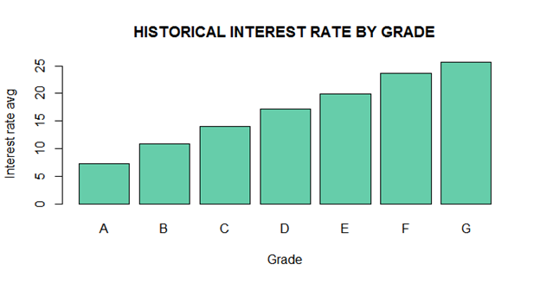
Data Visualization
barplot(matrix(c(mean(gradeA[["int_rate"]]),
mean(gradeB[["int_rate"]]),
mean(gradeC[["int_rate"]]),
mean(gradeD[["int_rate"]]),
mean(gradeE[["int_rate"]]),
mean(gradeF[["int_rate"]]),
mean(gradeG[["int_rate"]])),nr=1),
col=c("aquamarine3"),
names.arg=LETTERS[1:7],
main = "HISTORICAL INTEREST RATE BY GRADE",
ylab="interest rate avg",
xlab="Grade")

Slide 8
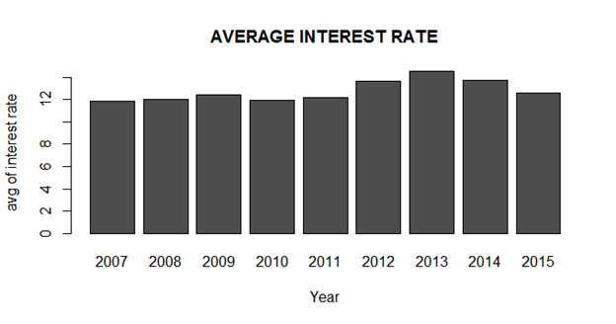
Data Visualization
colnames(avg_int_rate) <-
c("2007","2008","2009","2010","2011","201 2","2013","2014","2015")
rownames(avg_int_rate) <- c("int_rate")
avg_int_rate <- as.table(avg_int_rate)
barplot(avg_int_rate,
main = "AVERAGE INTEREST RATE",
xlab="Year",
ylab="avg of interest rate")

Slide 9
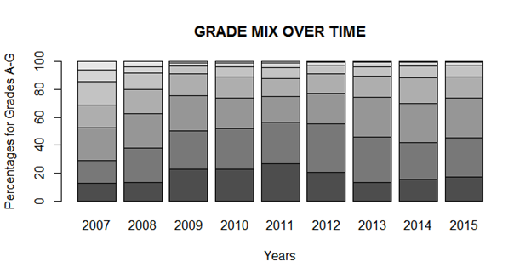
Data Visualization
colnames(grade_mix_year)
<- c("2007","2008","2009","2010","2011",
"2012","2013","2014",2015)
rownames(grade_mix_year)
<- c("A","B","C","D","E","F","G")
grade_mix_year_table
<- as.table(grade_mix_year)
barplot(grade_mix_year_table,
main='GRADE MIX OVER TIME',
ylab="Percentages for Grades A-G",
xlab = "Years")

Slide 10
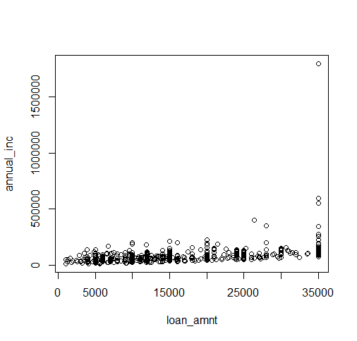
Data Visualization
library(plot)
attach(LoanDataSet)
plot(loan_amnt, annual_inc)

Slide 11
Data Pre-Processing
Used data dictionaries to check the meaning of each attribute and decided which attributes should be kept and which should be eliminated.
Checked for the uniqueness rule and null rule.
We concluded that interest rate increases based on grade (A - G). But, this does not have an impact on Customer’s Loan repayment. Hence, we eliminated that attribute for the sake of classification.
An attribute “verification_status” shows if the customer’s income has been verified or not.
For our analysis, verification_status attribute with “not verified” status could not be considered.

Slide 12
Data Pre-Processing
This was verified using SQL queries based on sqldf package available in R.
Applied correlation coefficient to identify relationship between attributes.
Here are the outputs of our analysis:
Correlation – Coefficient (loan_amount and funded_amnt) = 0.9993684
Correlation – Coefficient (loan_amount and funded_amnt_inv) = 0.9975263
Correlation – Coefficient (recoveries and collection_recovery_fee) = 0.8572363
The results showed that funded_amnt, funded_amnt_inv and collection_recovery_fee attributes from the data set were highly correlated.

Slide 13
Data Pre-Processing
We applied Object identification approach where we replaced member_name to member_title, as both have the same meaning and combined both the attributes.
We also checked for the derived attributes i.e installment which is calculated using Simple Interest formula.
It was found to be derivable using the data dictionary.
We also did data reduction such as, attribute ‘term’ had only two values “36 months” or “60 months”. So, we replaced “36 months” as 3 and “60 months” as 5.

Slide 14
Data Pre-Processing
Calculated LTI based on formula loan_amnt / annual_inc and eliminated loan_amnt and annual_inc from the classification criteria.
Identified loan status as label attribute to classify the data and scaled data from 1 to 6.
1- Fully paid,
2 - Current,
3 - Grace Period,
4 - Late(16-30 days),
5 - Late (30-120 days),
6 - Default/Charged off.
Converted loan status data to binary data (1 – loan_status as 1 and 0 – loan_status as 3, 4, 5 and 6).

Slide 15
Implementation
We have applied two algorithms Neural Network and Decision Tree for finding classifiers of our project.
We took random sample of 2 lakhs tuples from the processed dataset and applied both algorithms on that training set.
Then, we applied this classification model to test the data and compared performance of both techniques.

Slide 16
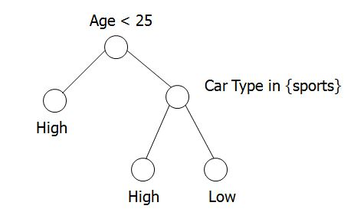
Decision Tree
Builds an accurate model for each class based on the set of attributes.
Used to classify the future data for which the class labels are unknown
Simple and easy to understand
It is built in 2 different phases
1) Tree Building Phase
2) Tree Pruning Phase

Slide 17
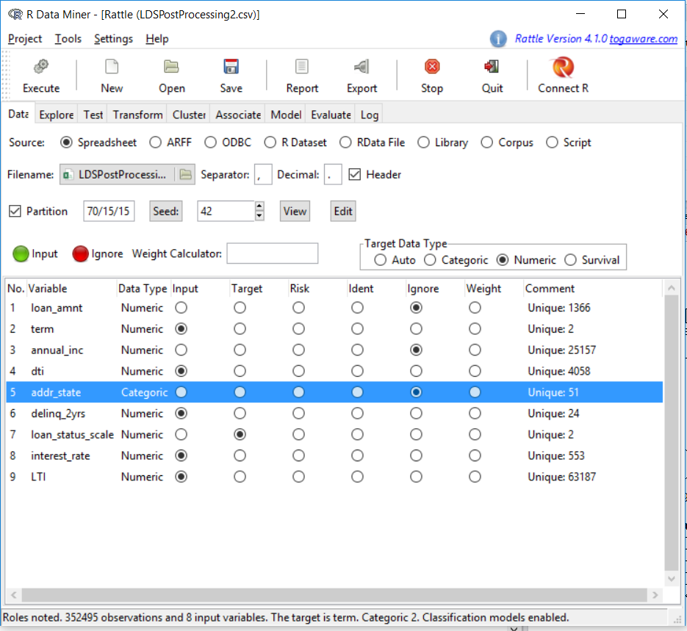
Implementation of Decision Tree
Rpart, partykit and rattle are the packages that we have implemented the decision tree.
Rattle – GUI based tool simple and intuitive interface that allows a user to quickly load data from a CSV file (or via ODBC).
Transform the models.
Build and evaluate models

Slide 18
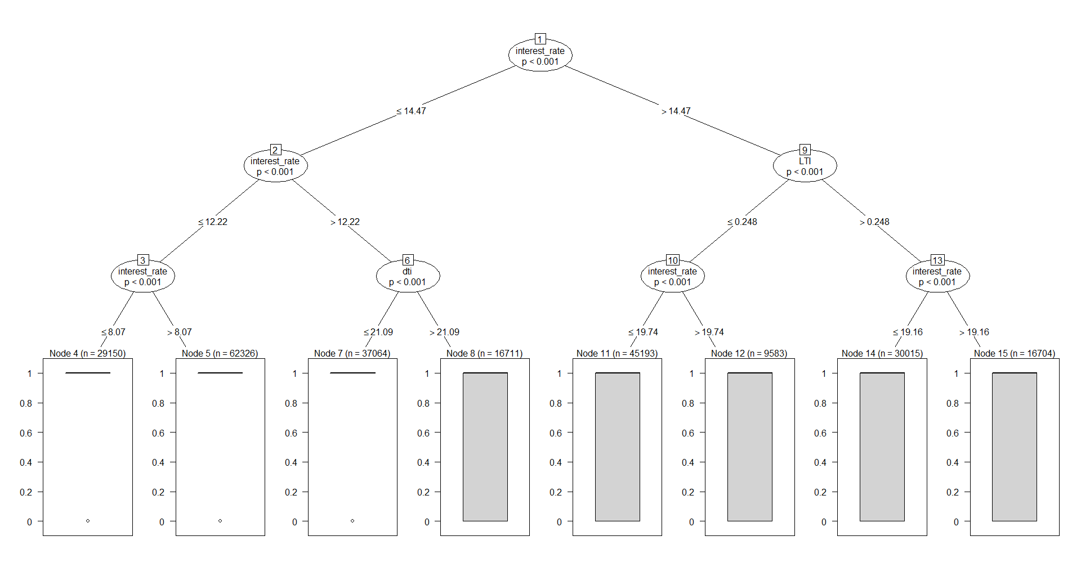
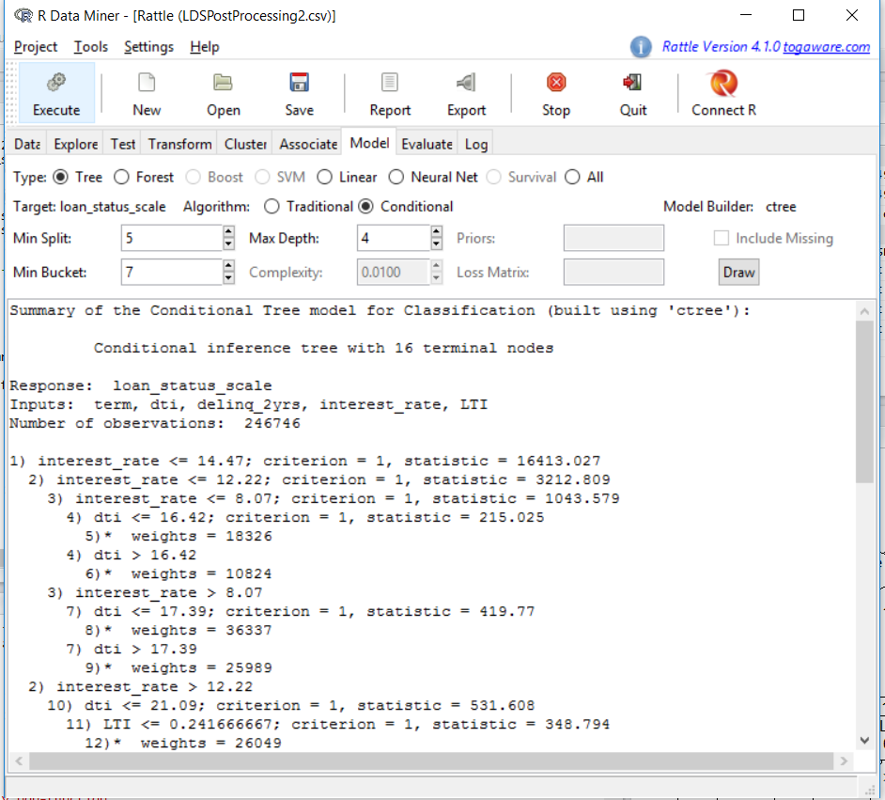
Implementation of Decision Tree
Parameters used in the algorithm:
1) Min Split – minimum observations in a node to split
2) Min Depth – minimum depth of the tree
3) Min Bucket – minimum observations in any leaf node
Inbuilt feature of the tool to draw the Decision Trees.
Multiple tree structures were produced for different samples and they did not classify completely.

Slide 19
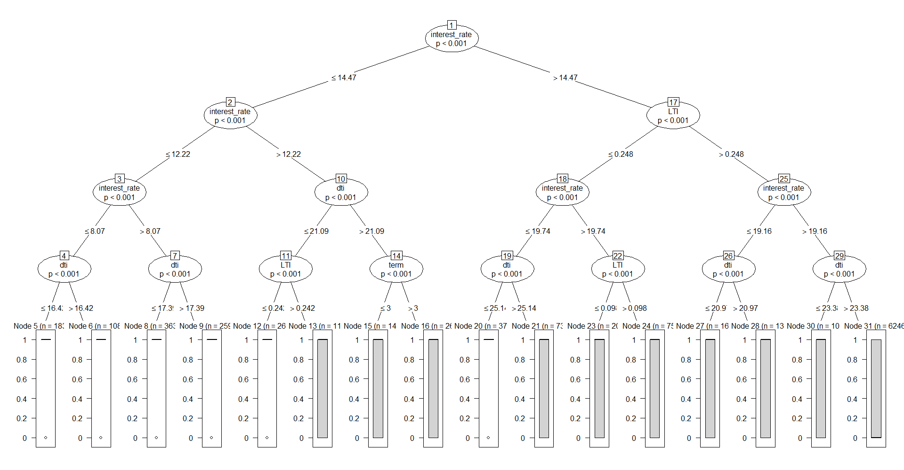
Another Decision Tree Produced

Slide 20
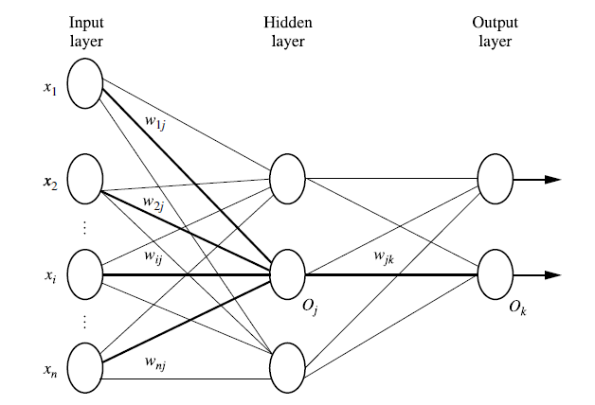
Neural Network
A Neural Network(NN) is a set of connected input/output units in which each connection has a weight associated with it. It consists of an input layer, one or more hidden layers, and output layer.
The most popular neural network algorithm is backpropagation algorithm. Backpropagation learns by iteratively processing a data set of training tuples, comparing the network’s prediction for each tuple with the actual known target value.

Slide 21


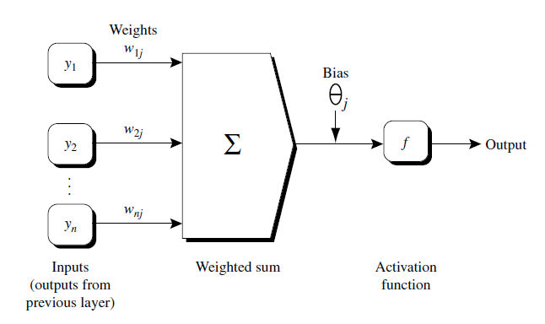



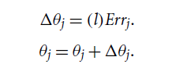
Working of Neural Network

Slide 22
Implementation of Neural Network
Neuralnet package is used in our project for the implementation of Neural Network in R Language.
Parameters used for the Neural Network:
1. Formula : loan_status_scale as a label for the classifiers which is 1 for safe and 0 for not.
2. Hidden : Number of hidden neurons (vertices) in each layer. For Example, 3.
3. Data: : Data frame containing the variables specified in formula.
4. Stepmax : It used to denote maximum steps to be taken by Neural Network to make decision.
5. Linear.output : If act.fct should not be applied to the output neurons set linear output to TRUE, otherwise to FALSE. act.fct is a differentiable function that is used for smoothing the result of the cross product of the covariate or neurons and the weights.
6. Algorithm : We have used back propagation algorithm for the Neural Network.
7. Learningrate : Numeric value specifying the learning rate used by backpropagation algorithm.

Slide 23
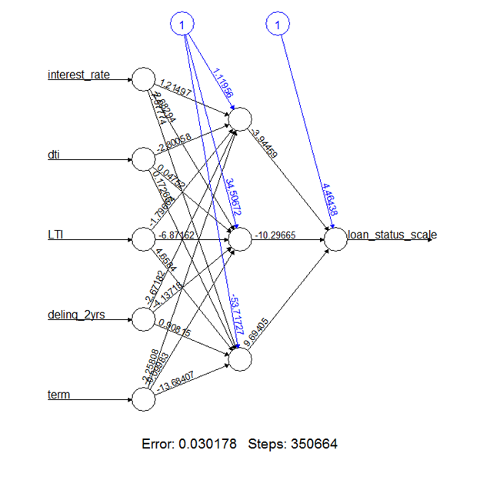
Output of Neural Network

Slide 24
Results of Neural Network
Following table shows the error rate, threshold and number of steps taken by neural network on the dataset.
Error Reached Threshold Steps
0.03017827207 0.009807199889 350664
Following table shows the predicted output of the neural network algorithm on randomly selected training data/
Row No. Predicted Output Rounded Output
256787 0.001306933596780 0
48261 0.980898108148450 1
112665 0.975315861413863 1
68244 0.005140151071020 0
192115 0.975243968591713 1
312040 0.995559115228409 1
343895 0.999998616327410 1
265073 0.002298431765039 0
64211 0.999939205424671 1
110660 0.091024995284347 0

Slide 25
Applying Classifiers on Testing Data
Following table shows the predicted and actual output of randomly selected testing data after applying neural
network algorithm on them.
Row no. Actual Prediction
17440 1 1
302221 0 0
243882 1 1
171675 1 1
291419 1 1
118959 0 0
123795 0 1
84923 1 1
251919 0 0
344686 1 1

Slide 26
Conclusion
This project was able to produce classifiers on historical loan data collected from various banks.
These results can aid bankers to identify customers who cannot repay the loan based on the classifiers produced.
This was achieved by two algorithms i.e. Neural Network and Decision Tree. We compared performance of both techniques, out of which Neural Network works well with Numeric as well as binary data and produce better and accurate results.

Slide 27
Future Work
As large number of loans given by banks and private companies in different sectors, prediction of whether person can repay the loan or not has become very important these days.
Also, huge amount of information produced by Loan data, scalability issues need to be resolved by performing mining task on Hadoop platform.
As we mined data based on only two algorithms like Decision Tree and Neural network, this can be achieved using other algorithms to compare the performance and accuracy of the results to make it better.

Slide 28
References
Sridhar, V. Predictive Mining on Loan Data using Rattle. International Journal of Advanced Research in Computer Science, pp 1 – 10, Vol. 04/10, Sep – Oct 2013.
Edward, L., Gregory E. A Comparative Analysis of Payday Loan Customers. Contemporary Economic Policy, pp 299 – 316, Vol. 26/2, Apr 2008.
Reby, D., Lek, S., Dimopoulos, I., Joachim, J., Lauga, J., &Aulagnier, S. (1997). Behavioural Processes. Artificial Neural Networks as a Classification Method in the Behavioural Sciences,40, 35-43.
We referred website https://www.lendingclub.com/ to understand how lending club company is dealing with Loan approval.
We referred Article “Using neural networks for credit scoring: a simple example” from the website http://www.r-bloggers.com/using-neural-networks-for-credit-scoring-a-simple-example/
We referred book “Data Mining Concepts and Techniques – Third Edition by Jiawei Han for understanding the working of Decision Tree and Neural Network algorithms.

Slide 29
Questions ?

Slide 30
Thank You !

